Slide 1
How to Become Invisible On the Web: Tor and VPNs
Greyhat
2/2/17

Slide 2
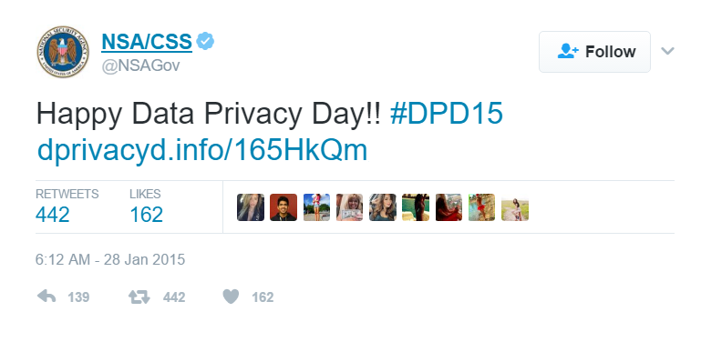
Who Wants My Data?
Google
Amazon
FBI
CIA
NSA
Everyone (you’re famous!)
Notes:
Quick aside…

Slide 3
Source: http://www.baynote.com/infographic/big-brother-is-a-tech-company/?utm_source=datafloq&utm_medium=ref&utm_campaign=datafloq

Slide 4
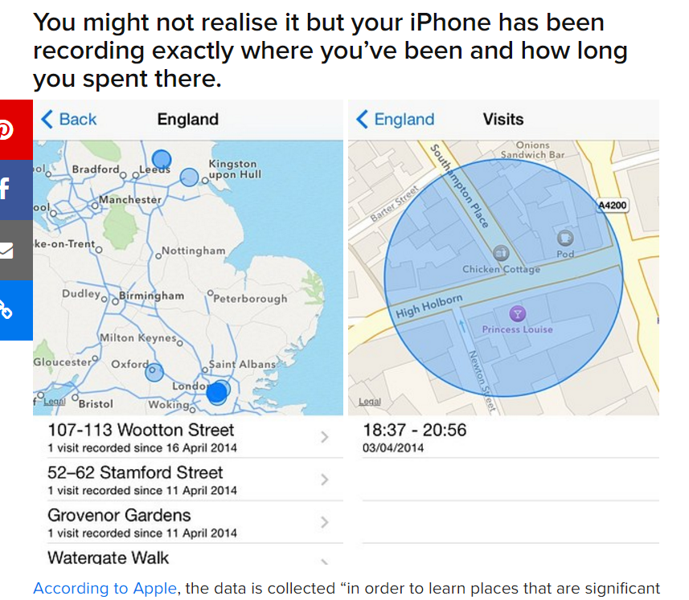
Source: https://www.buzzfeed.com/jimwaterson/your-iphone-knows-exactly-where-youve-been-and-this-is-how-t?utm_term=.heelgmWX4#.bgX9B1EZr
Notes:
Would you feel safe blowing whistles without this info out there?

Slide 5
But I don’t care about companies buying my data; I’d sell my soul in a heartbeat!
Anonymity is extremely effective in promoting freedom of expression
Anonymity lets you do questionable things
Anonymity is unavoidable
Knowledge
Notes:
Anonymity provides outlets to voice unpopular opinions
Technology
Even if you don’t support; best to learn how others do it
-> Maybe you want to work for unnamed three-letter agencies one day!

Slide 6
How Can I Be Anonymous?
Ski Masks
Black Hoodies
Sunglasses
Use Virtual Machines
Disable all JavaScript
Throw away Email Accounts
Tor
VPNs
Proxies
Encryption

Slide 7
The Onion Routing Network/Protocol
A way to connect to the internet anonymously
Started as DARPA project funded by Navy in 1995
Free and open-source since 2003
Run by volunteers
http://video.mit.edu/watch/how-tor-works-502/

Slide 8
How Does it Work?
Normally:
IP: 128.61.117.197
Dest: 104.16.160.135
Logging visit by: 128.61.117.197?
IP: 128.61.117.197?
Oh, that’s Sid!
He’s going to: 104.16.160.135
Gov/Unwanted Parties

Slide 9
How Does it Work?
With Tor:
IP: 128.61.117.197
Going to: Tor Node
Logging Visit By: 91.29.93.49
IP: 128.61.117.197?
Oh, that’s Sid!
He wants to go to…Tor? Ok.

Slide 10
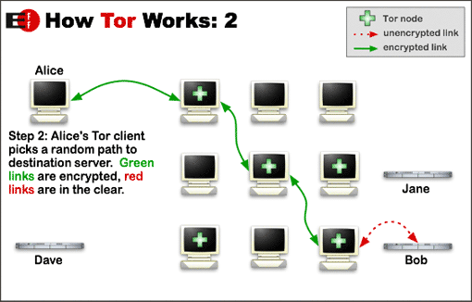
Tor and Encryption
1. The client encrypts the original data in such a way that only the exit relay can decrypt it.
2. This encrypted data is then encrypted again in such a way that only the middle relay can decrypt it.
3. Finally, this encrypted data is encrypted once more in such a way that only the guard relay can decrypt it.
Notes:
Middle = Middle Relay
Exit = Exit Relay
Entrance..? Guard Relay!
Encryption except on last hop

Slide 11
Notes:
Layers like an Onion
At each relay, a layer is “peeled off”

Slide 12
Random Facts about Tor
Only runs TCP streams
Circuit is reused for communications within same ten minutes.
Later requests new circuit
Websites that can only be accessed through Tor are called Tor Hidden Service
Colloquially the collection of these websites are known as …
Typical address:
http://3g2upl4pq6kufc4m.onion/
Notes:
Fun fact – be careful when you image search “deep web”!
Be careful when visiting .onion websites – many many are scams and viruses
Offering to take my bitcoins, double them, and give them back? Seems legit!
Currently there’s ~6000 relays

Slide 13
Concerns
Can’t my ISP just trace my path through the Tor Nodes?
No!
Each link doesn’t know anything about who the data originally came from or where it’s ultimately going;
Only knows what is the next hop.
Data is also encrypted
If I want to use Tor in a place where Tor isn’t allowed, can’t they just block connections to the first relay?
Yes, but no.
If I run an exit relay, won’t there be a lot of shady traffic coming from my computer?
Yes!
If you really want everything to be totally anonymous, make sure you’re encrypting your data traffic
Use HTTPS: https://www.eff.org/pages/tor-and-https
Notes:
Bridge Relay nodes are not publicly made available
You can send an email asking for some bridge relays to use to the torproject and they will send you a few IPs.
-> Have to do it through Gmail or Yahoo though to prevent spam emails
Feds, DMCA Notices, abuse complaints

Slide 14
Times when Tor Failed
Harvard Bomb Threat
Student wanted to get out of final
Sent in fake bomb threats through email
Used Tor to anonymize the IP that email was coming from
Issues
Didn’t use a bridge relay
Did this over campus Wi-Fi, logged in

Slide 15
Times when Tor failed
Lulzsec’s Sabu
Usually used Tor to connect to IRC
One day, he got lazy and didn’t.
Feds found his home IP
Gave out personal info in IRC server
Notes:
Lulzsec – black hat computer hacking group, fell after their leader Sabu was caught
Attacked CIA and Nintendo – that’s when you know you’ve messed up as a hacking organization

Slide 16
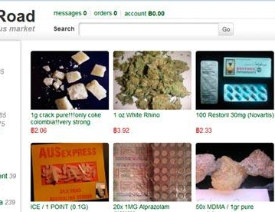
Times when Tor failed
Silk Road – a Tor Website
Someone by the name of “Dread Pirate Roberts” was running the Silk Road
$1.2 billion dollar industry - feds are interested!
They try to find earliest references on internet to Silk Road
On Shroomery, a user named “altoid” advertises
On BitcoinTalk, a user named “altoid” asked if anyone had seen “this new anonymous Amazon”
Altoid then makes a post on Bitcointalk about looking for an “IT pro in the bitcoin community” and asked interested parties to contact
“rossulbricht at gmail dot com” (10/11/11)
http://stackoverflow.com/questions/15445285/how-can-i-connect-to-a-tor-hidden-service-using-curl-in-php
Notes:
Shroomery – altoid advertises cool new marketplace on forums
BitCoinTalk – altoid asks if anyone had seen this new anonymous amazon
Quickly changed username to “Frosty”
But first username was “Ross Ulbricht”
Common Trend – Users were dumb. Trend in security overall; implementation is usually at fault, not the theory

Slide 17
Actual Attacks
Correlation Attacks
21.1 MB
21.1 MB
Notes:
Theoretically just “own a lot of the nodes”

Slide 18
Solution: Entry Guards
Put fate in hands of probability
An attacker owns C Tor relays, and the entire network has N total relays
If you select new entry and exit relays each time, attacker has (C/N)*2 probability of correlating your traffic
Assert that attacker correlating your traffic even once is as bad as it happening multiple times
Counter-intuitive solution
Each Tor client picks a handful of nodes from N to use at random as entry relays
This handful never changes
You had on order of (N-C)/N chance of picking safe nodes
N = 1000, C = 3 → 997/1000 = 99.7% chance of safety
Better than nothing
Notes:
As long as no one owns a majority of the nodes, odds are in your favor

Slide 19
https://arstechnica.com/security/2015/07/new-attack-on-tor-can-deanonymize-hidden-services-with-surprising-accuracy/
Malicious Nodes
Notes:
MIT
Own a lot of entry guards
Look for patterns in the number of packets through the guard.
ML algorithms with 99% accuracy could determine whether the circuit was ordinary browsing, an introduction-point circuit, or a rendezvous-point circuit.
CMU attack – murky details; inject tags to trace the route of the packets.
Was going to give a talk on how they did it; canceled it a few months before.
FBI still hasn’t revealed how they do it; supposedly NSA has already been able to find people on Tor for years.
Some research today:
Performing graph analysis on data flows to de-anonymize the traffic

Slide 20
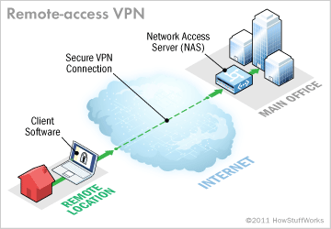
VPN
“Protocol that allows users to send and receive data across shared or public networks as if their computing devices were directly connected to the private network” – Wikipedia
Requires a VPN provider willing to send your traffic through
Traffic is encrypted
Notes:
Doing shady stuff requires a VPN provider willing to not give you up
From research, this appears to be countries in Eastern Europe and the Nordic region

Slide 21
VPN->Tor? Tor->VPN?
Extra security
Mitigates some of the drawbacks of using each exclusively
Your computer -> VPN -> Tor -> internet
ISP won’t know you’re using Tor
VPN provider knows you’re using Tor and Real IP
Your computer -> Tor -> VPN -> internet
VPN provider can’t see your IP
VPN provider can see your traffic
No steadfast rule on which is better

Slide 22
Deep Web
Tor Hidden Service – Websites only accessible through Tor
Demo!

Slide 23
General Parting Advice
Use Tor Browser
Most safe way to use Tor; preconfigured settings make sure of this.
Don’t torrent over Tor
Tend to ignore proxy settings and make direct connections even when told not to.
Don’t enable browser plugins
Use HTTPS
Don’t open documents downloaded through Tor Online
VERY VERY IMPORTANT
If absolutely needed, open it with network settings off inside a VM
Use a bridge node

Slide 24
Resources
https://www.youtube.com/watch?v=7G1LjQSYM5Q
https://arstechnica.com/security/2015/07/new-attack-on-tor-can-deanonymize-hidden-services-with-surprising-accuracy/
https://blog.torproject.org/blog/one-cell-enough
http://jordan-wright.com/blog/2015/02/28/how-tor-works-part-one/
https://www.torproject.org/docs/faq.html.en#EntryGuards
Tor Website
The Internet

